Slide 1
A FRAMEWORK FOR REVERSE ENGINEERED ANDROID APPLICATIONS THROUGH MACHINE LEARNING ALGORITHMS
MALWARE DETECTION
Presented By:
1. Kamble Pallavi-CMRTC-CSE

Slide 2
OUTLINE
Problem Statement
System Development Approach
Algorithm & Deployment
Result
Conclusion
Future Scope
References

Slide 3
Problem Statement
The framework aims to analyze reverse-engineered Android applications using machine learning algorithms to detect vulnerabilities, tampering, and unauthorized modifications.
By leveraging machine learning models, the system identifies patterns, anomalies, and behaviors within reverse-engineered applications.
The framework efficiently detects malware, security breaches, and code manipulation, enhancing overall app security.
It automates the process of analyzing large numbers of Android applications, improving accuracy and reducing manual effort.
This framework supports developers, researchers, and security professionals in safeguarding Android apps from reverse engineering threats.

Slide 4
System Approach
The "System Approach" section outlines the overall strategy and methodology for developing and implementing A FRAMEWORK FOR REVERSE ENGINEERED ANDROID APPLICATIONS THROUGH MACHINE LEARNING ALGORITHMS :
System requirements
Library required to build the model

Slide 5
System requirements
Software Requirements
For developing the application, the following are the Software Requirements:
Python
Django
MySQL
Wamp Server
HTML,CSS,JAVASCRIPT.

Slide 6
System requirements
Hardware Requirements
For developing the application, the following are the Hardware Requirements:
Processor: i3 or more
RAM: 4GB
Space on Hard Disk: minimum 20GB

Slide 7
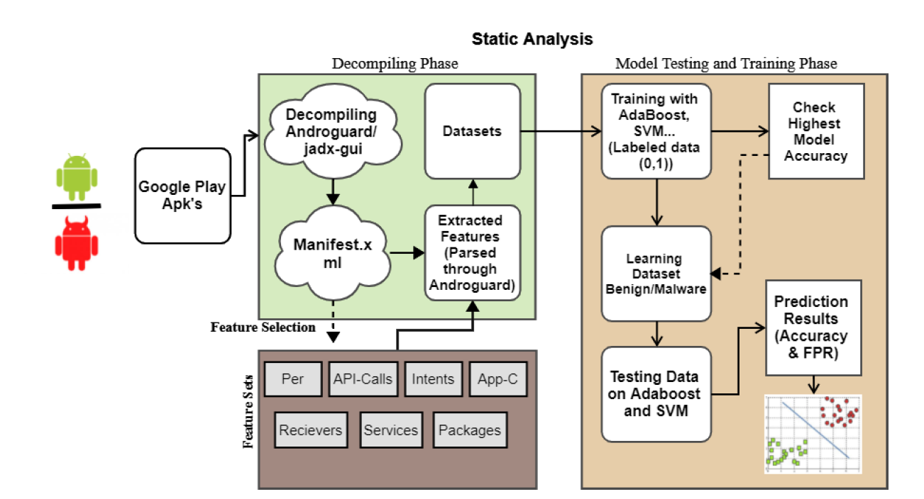
Algorithm & Deployment

Slide 8
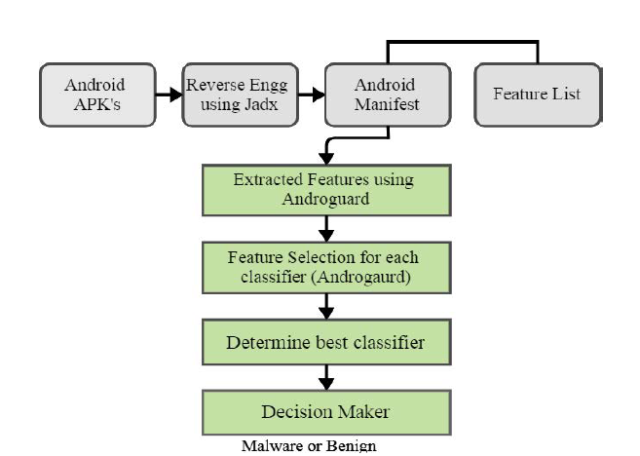
architecture

Slide 9
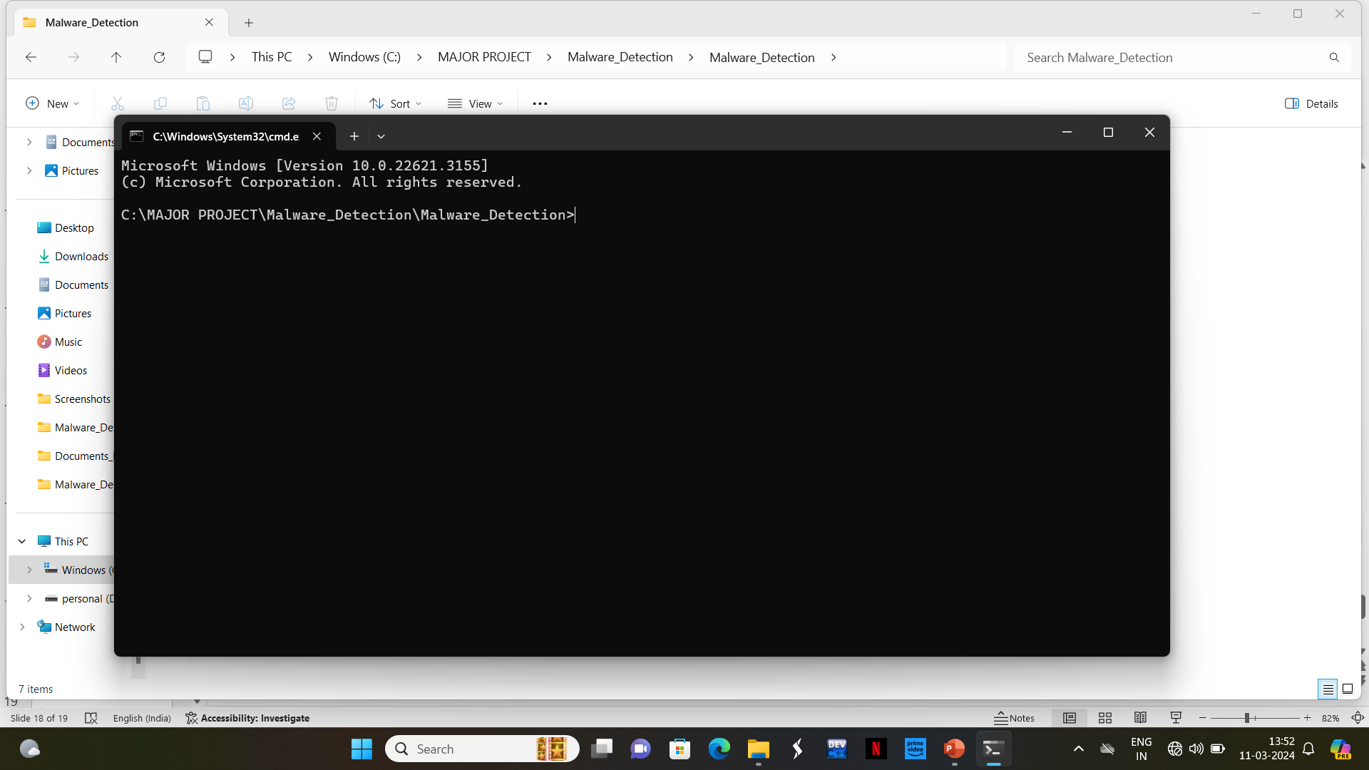
Result

Slide 10
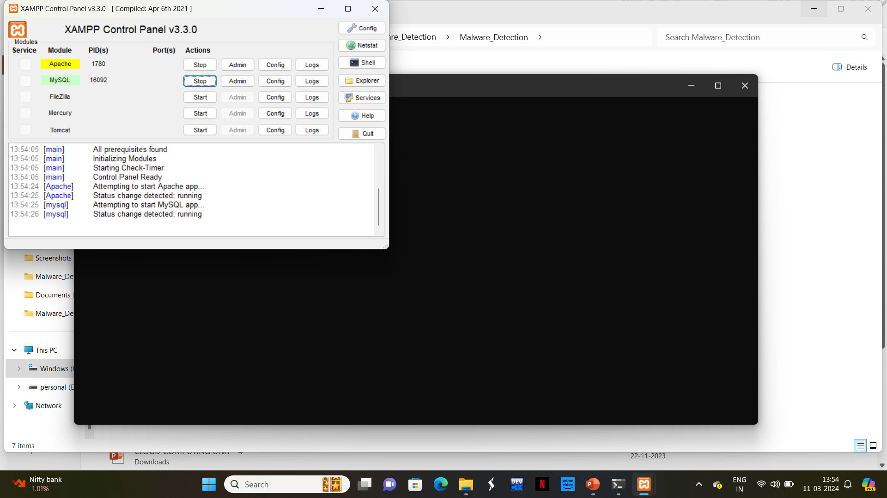
Result

Slide 11
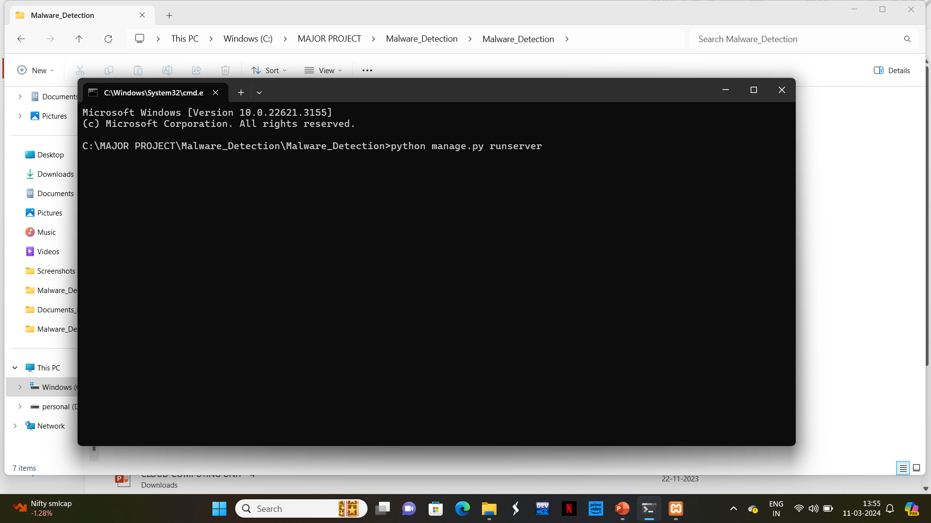
Result

Slide 12
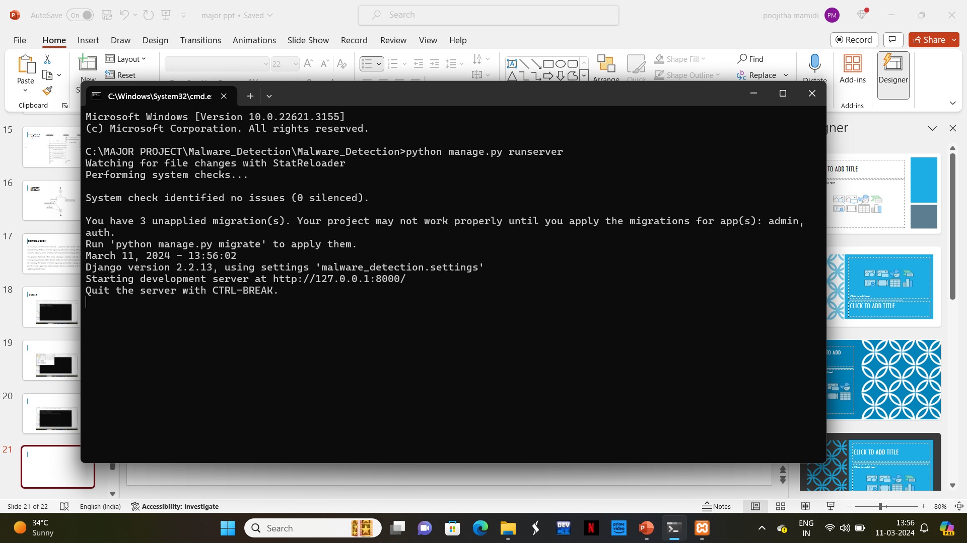
Result

Slide 13
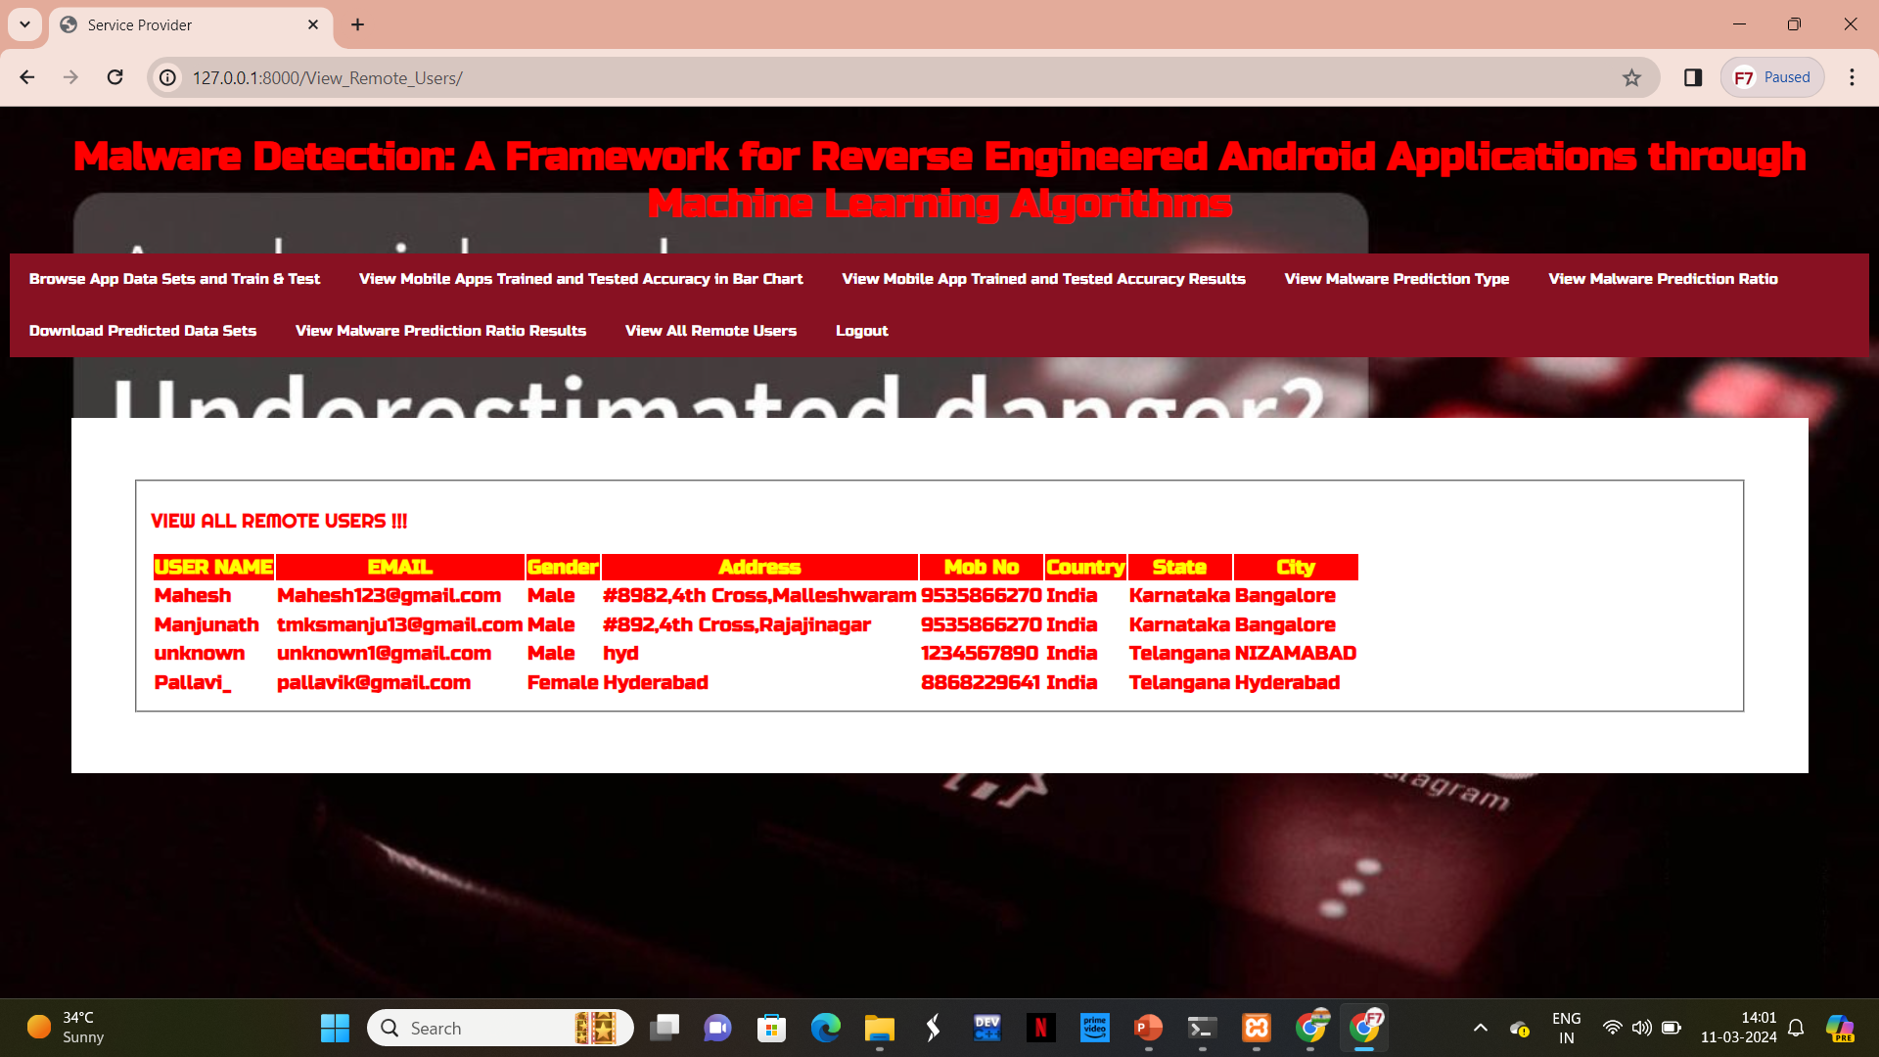
Result

Slide 14
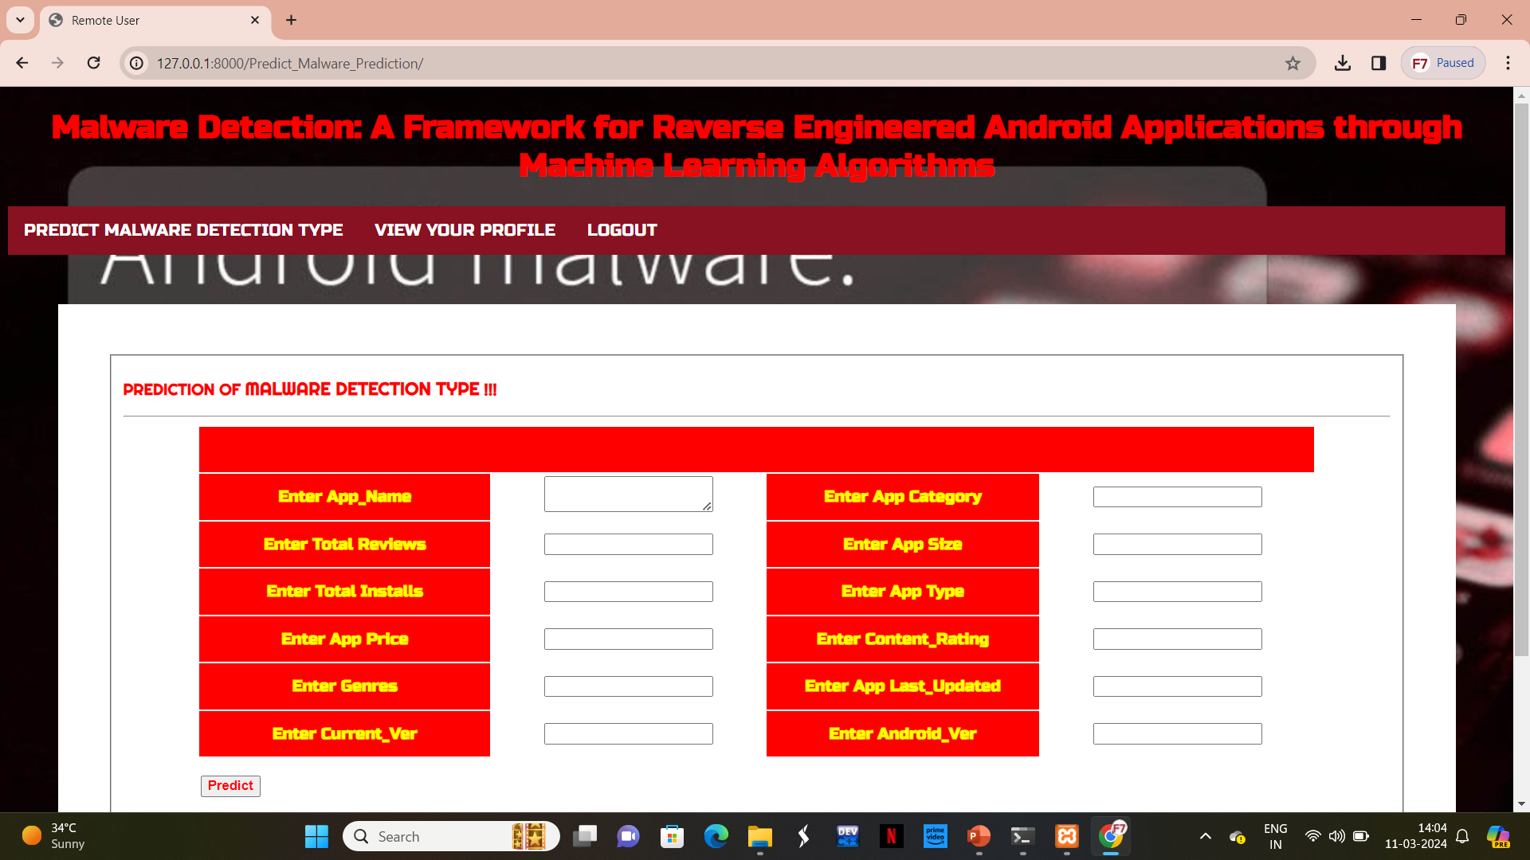
Result

Slide 15
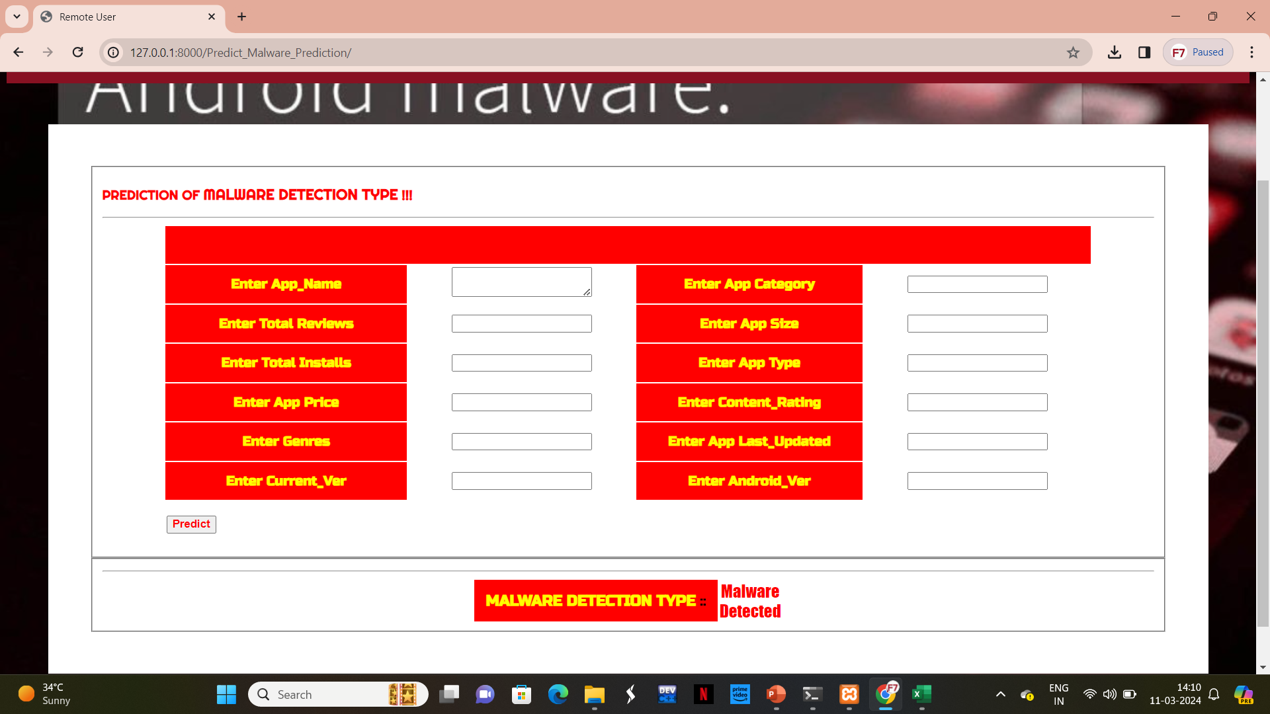
Result

Slide 16
Conclusion
In conclusion, our framework represents a significant step towards combating Android malware through the fusion of reverse engineering and machine learning, offering a promising avenue for enhancing mobile security and protecting users from emerging threats.
The proposed framework offers several advantages, including scalability, adaptability to evolving malware threats, and the ability to handle real-world Android applications effectively. By combining the strengths of reverse engineering and machine learning, our framework provides a holistic approach to Android malware detection, contributing to the overall security and privacy of mobile users.

Slide 17
Future scope
Privacy-Preserving Techniques: With increasing concerns about data privacy, future frameworks may incorporate privacy-preserving techniques to ensure that sensitive user data is adequately protected during the malware detection process.
Integration with Security Ecosystems: Future frameworks may be designed to seamlessly integrate with existing security ecosystems, including antivirus software, intrusion detection systems, and security information and event management (SIEM) platforms. This integration would enable comprehensive threat detection and response capabilities.
User Education and Awareness: Finally, alongside technological advancements, there will be a continued need for user education and awareness regarding the risks associated with Android malware. Future frameworks could incorporate features to educate users about safe browsing habits and best practices for app installation and security.

Slide 18
References
[1] Android (GOOG) Just Hit a Record 88% Market Share of All SmartphonesQuartz. Accessed: Jan. 28, 2022.
[2] A. O. Christiana, B. A. Gyunka, and A. Noah, ``Android malware detection through machine learning techniques: A review,'' Int. J. Online Biomed. Eng., vol. 16, no. 2, p. 14, Feb. 2020
[3] D. Ghimire and J. Lee, ``Geometric feature-based facial expression recognition in image sequences using multi-class AdaBoostand support vector machines,'' Sensors, vol. 13, no. 6, pp. 77147734, Jun. 2013
[4] R. Wang, ``AdaBoost for feature selection, classification and its relationship with SVM, a review,‘’ Phys. Proc., vol. 25, pp. 800807, Jan. 2012
[5] J. Sun, H. Fujita, P. Chen, and H. Li, ``Dynamic nancial distress prediction with concept drift based on time weighting combined with Adaboost support vector machine ensemble,'' Knowl.- Based Syst., vol. 120, pp. 414, Mar. 2017,
[6] H. Cai, ``Assessing and improving malware detection sustainability through app evolution studies,‘’ ACMTrans. Softw. Eng. Methodol., vol. 29, no. 2, pp. 128, Apr. 2020

Slide 19
THANK YOU

